Slide 1
A Novel TF-IDF Weighting Scheme for Effective Ranking
By Jiaul H. Paik, Indian Statistical Institute, Kolkata, India
Presented By
Sharanya Dasgupta

Slide 2
INTRODUCTION
This Paper proposes a novel TF-IDF term weighting scheme that employs two different within document term frequency normalizations to capture two different aspects of term saliency. One component of the term frequency is effective for short queries, while the other performs better on long queries. The final weight is then measured by taking a weighted combination of these components, which is determined on the basis of the length of the corresponding query.

Slide 3
PRELIMINARIES
Given a query Q and a document D, the main task of a ranking function is to assign a score to D with respect to the query Q. Thus, before we give the main motivation behind our work, let us first revisit the three key hypotheses.
Term Frequency Hypothesis (TFH):
The weight of term in a document should increase with the increase in term frequency (TF). However, it seems unlikely that the importance of a term grows linearly with the increase in TF. Therefore, researchers have used dampened and the damping function has been log(TF).

Slide 4
PRELIMINARIES
Advanced TF Hypothesis (AD-TFH):
The rate of change of weight of a term should decrease with the larger TF. For example, the change in the weight caused by increasing TF from 2 to 3 should be higher than that caused by increasing TF from 25 to 26. Formally, we hypothesize that, a function Ft(TF), that maps the original TF to the resultant value (which will be used for final weighting), should possess the following two properties.
F’t(TF) > 0 (b) F’’t(TF), < 0

Slide 5
PRELIMINARIES
Document Length Hypothesis (DLH):
Long documents tend to use a term repeatedly, thus term frequency can be higher in a long document. Thus, it is necessary to regulate the TF value in accordance with the document length. The general principle is that if two documents have different lengths and the same TF values for a term t, then the contribution of TF (of t) should be higher for the shorter document.
Term Discrimination Hypothesis (TDH):
If a query contains more than one term, then a good weighting scheme should prefer a document that contains the rare term (in the collection).

Slide 6
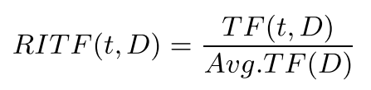
Two Aspects of TF
Relative Intra-document TF (RITF) :
In this factor, the importance of a term is measured by considering its frequency relative to the average TF of the document. Thus, a natural formulation for this could be
where TF(t,D) and Avg.TF(t,D) denote the frequency of the term t in D and average term frequency of D respectively. However, this may too much prefer excessively long documents, since the denominator is close to 1 for a very long document.

Slide 7
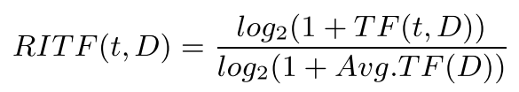
Two Aspects of TF
Hence, a sublinear damping of TF seems to be a better choice over the raw TF and thus we use the following function.
Length Regularized TF (LRTF) :
This factor normalizes the term frequency by considering the number of terms present in a document. Thus, a reasonable starting point could be TF(t,D)× ADL(C) / len(D) ,where ADL(C) is the average document length of the collection and len(D) is the length of the document D.

Slide 8

Two Aspects of TF
But once again, it seems unlikely that the increase in term frequency follows a linear relationship with the document length, and thus the above formula over-penalizes the long documents. To overcome this bias, we employ the following function to achieve the length dependent normalization. It still punishes the long documents but with diminishing effect.

Slide 9
Motivation to use of two TF factors
Let D1 and D2 be two documents of equal lengths, with the following statistics.
1. len(D1) = 20, #distinct term of D1 =5, TF(t,D1)=4
2. len(D2) = 20, #distinct term of D2 = 15, TF(t,D2)=4
In both of the cases, LRTF considers t equally important which is not appropriate, since the focus of the document D1 seems to be divided equally among 5 terms and therefore t should not be considered salient, while t seems to be important for D2.Thus, in the later case RITF seems to be a better choice to LRTF.

Slide 10
Motivation to use of two TF factors
Let D1 and D2 be two documents with the following statistics.
1. len(D1) = 20, #distinct termof D1 = 15, TF(t,D1)=4
2. len(D2) = 200, # distinct term of D2 = 150, TF(t,D2)=4
For this instance however, RITF considers the term t equally important for both D1 and D2, which is not right, since D2 contains more distinct terms and thus seems to cover many other topics (also possibly uses t repeatedly). Therefore, in later case, the use of LRTF seems to be a potential choice over RITF. Our main goal now is to integrate the above two factors into our weighting scheme. However, we do not use the TF factors as defined earlier. We transform these TF values for our final use that in some sense makes use of the hypothesis AD-TFH.

Slide 11
Transforming TF Factors
A good weighting function, while emphasizing on term frequencies and term discrimination factors, should also pay attention to the term coverage issue (i. e number of match). For example, if a document D1 contains a query term 10 times and another document D2 contains two query terms (of the same query) 5 times each, then the assigned score should be higher for D2 (assuming that both the query terms have equal term discrimination values).

Slide 12
Transforming TF Factors
Second, another common trait of many weighting schemes is that they use the TF functions that are not bounded above. We transform the TF factors using a function f(x) that possesses the following properties:
(i) vanishes at 0, (ii) satisfies the two conditions of AD-TFH hypothesis (f’(x) > 0and f’’(x) < 0), and (iii) asymptotically upper bounded to 1.
One of the simplest functions that satisfies the above properties is f(x)= x / 1+x .

Slide 13
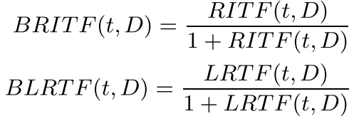
Transforming TF Factors
Using this function, we now transform the two TF factors as follows:

Slide 14
Combining Two TF Factors
Now the key question that we face: how should we combine BRITF(t,D) and BLRTF(t,D)? A natural way to do this is as follows:
where 0 <w < 1. The next important issues are that - Should we prefer BRITF(t,D)(w> 0.5) or BLRTF(t,D)(w< 0.5).
In order to answer these questions, we now analyze the properties of the two TF components. It is clear that BRITF(t,D) has a tendency to prefer long documents, since for long documents the denominator part of RITF(t,D) is close to 1, and TF is usually larger. On the other hand, BLRTF(t,D) tends to prefer short documents, since LRTF(t,D) → 0 as len(D) →∞.

Slide 15
Combining Two TF Factors
Therefore, when a query is long, BRITF(t,D) heavily prefers extremely long documents, since the number of matches is more or less proportional to the length of the document. On the contrary, since BLRTF(t,D) prefers short documents it can penalize extremely long documents when it faces longer queries, and thus it is preferable when longer queries are encountered. Another interesting property of BRITF(t,D) is that it emphasizes on the number of matches, since the main component of this formula RITF(t,D) heavily punishes the term frequency, and thus important for the short queries. Hence, for short queries BRITF(t,D) should be preferred, while for longer queries, BLRTF(t,D) should be given more weight.

Slide 16
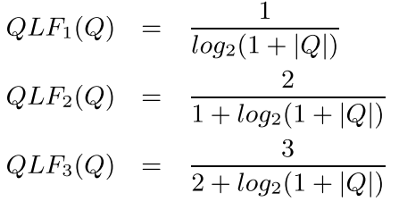
Combining Two TF Factors
we now turn to incorporate the query length information into our weighting formula. The value of w should decrease with the increase in query length, while it must lie between [0-1]. Specifically, we characterize the query length factor QLF(Q) by the following variables. (i) QLF(Q)=1 for |Q| = 1, (ii) QLF’(Q) < 0 and
(iii) 0 < QLF(Q) < 1. Numerous different functions can be constructed that satisfy the above conditions. We used the following three different functions.

Slide 17
Combining Two TF Factors
The first function descends more rapidly than the second function, while the second function descends more rapidly than the third function. Experiments suggest that 2nd function performs consistently better than the other two functions on all the collections. Hence, we set w = QLF2(Q).

Slide 18

Term Discrimination Factor
The goal of the term discrimination factor in weighting is to assign higher score to the documents that contain the terms which are rare in the collection. Inverse document frequency (IDF) is a well known measure that serves the above purpose. We use the following standard idf measure.
The above IDF measure considers only the presence or absence of a term in a document and does not take into account the document specific term occurrence.

Slide 19

Term Discrimination Factor
We hypothesize that if two terms have equal document frequencies, then the term discrimination should increase with the increase in average elite set term frequency. The average elite set term frequency (AEF) is defined as CTF(t,C) / DF(t,C) ,where CTF(t, C) denotes the total occurrence of the term t in the entire collection. However, the combination of raw AEF with IDF may disturb the overall term discrimination value, since the IDF values are obtained by dampening through log function. Hence, we employ a slowly increasing function to transform the AEF values for this combination. Once again, we use the function f(x)= x/(1 + x) to transform the AEF values for the final use. The final term discrimination value of term t is computed as

Slide 20

Term Discrimination Factor
Experiments reveal that the use of the above term discrimination has not very significant effect on the overall performance. However, it is observed that the improvements, although are small, consistent across the collections.
Integrating the above factors we now obtain the following final scoring formula.
Final Formula

Slide 21

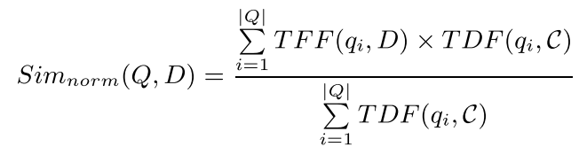
Final Formula
Again, since TFF(qi,D) < 1, we obtain the following relationship.
Therefore, we can easily modify final formula to get the normalized similarity scores (0 <Sim(Q,D) < 1) as follows:

Slide 22
Final Formula
Both Equations are equivalent in the sense that they produce the same ranked lists. However, an application that requires normalized scores, then last formula can be used as a suitable alternative.

Slide 23
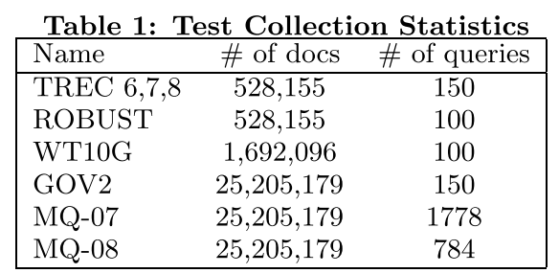
EXPERIMENTAL SETUP
Data- Following table summarizes the statistics on test collections used in our experiments. The experiments are conducted on a large number of standard test collections, that vary both by type, the size of the document collections and the number of queries. TREC 6,7,8 and ROBUST are news collections. WT10G is a web collection of moderate size, while GOV2 is another web collection of larger size, which is crawled from .gov domain. The MQ-07 and MQ-08 set of queries are based on the
Million Query Track 2007
and 2008 respectively.

Slide 24
EXPERIMENTAL SETUP
Except TREC-6,7,8, all the test collections have three scale graded relevance assessment. The grades are 0, 1 and 2- meaning non-relevant, relevant and highly relevant respectively. TREC-6,7,8 collection uses binary relevance assessment.

Slide 25
Evaluation Measures and IR System
All experiments are carried out using TERRIER1 retrieval system (version 3.5). Terrier is a flexible Information retrieval system which provides the implementation of many well known models. We use title field of the topics (note that two million query data contain more than 1000 queries that contain more than 5 terms). From all the collections we removed stop words during indexing. Documents and queries are stemmed using Porter stemmer. The following metrics are used to evaluate the systems.
Mean Average Precision (MAP): This is a standard metric for binary relevance assessment. MAP aggregates the Average Precision scores from multiple queries and calculates their mean.

Slide 26

Evaluation Measures and IR System
Normalized DCG at k (NDCG@k) : Discounted cumulative gain (DCG) is an evaluation measure that can leverage the relevance judgment in terms of multiple grades, and has an explicit position-wise discount factor. NDCG is the normalized version of DCG.
Expected Reciprocal Rank at k (ERR@k) : To relax the additive nature and the underlying independent assumption in NDCG, another evaluation measure, namely, Expected Reciprocal Rank (ERR) is proposed. It discounts the documents which are shown below very relevant documents, and is defined as the expected reciprocal length of time that a user will take to find a relevant document. ERR@k is computed as follows:

Slide 27
Evaluation Measures and IR System
where R(g)= (2^g − 1)/2^hg, hg is the highest grade and g1,g2 .. .gk are the relevance grades associated with the top k documents. The first two metrics are used to reflect the overall performance of the systems, while the last evaluation measure reflects better the precision of search results, thereby making more important for the precision oriented systems. ERR has been chosen as one of the official metrics for recent TREC web tracks.

Slide 28
Baselines
The performance of the proposed weighting scheme was compared with five state of the art retrieval models. Since the proposed weighting function is a TF-IDF based formula, we have taken two well known state of the art TF-IDF models. We have also chosen BM25, language model with Dirichlet smoothing (LM), and relatively recent divergence from randomness based formula (PL2) as the other state of the art baselines.
1. Pivoted length normalized TF-IDF model: This model is one of the best performing TF-IDF formula in the vector space model framework. The value of the parameter s is set to 0.05.
2. Lemur TF-IDF model: This model is another TF-IDF model that uses Robertson’s tf and the standard idf. The parameter of this model is set to its default value, 0.75.

Slide 29
Baselines
3. Classical Probabilistic model (BM25): The parameters of this model is set to k1 =1.2, b =0.6 and k3 = 1000. Note that we found (on training data) slightly better results for b =0.6 than the default 0.75.
4. Dirichlet smooth language model (LM): Language model is another probabilistic model that performs very effectively. For this model we set the value of Dirichlet smoothing (µ) to 1700.
5. Divergence from Randomness model (PL2): Similar to the previous models, its performance also depends on a parameter value (c in the formula). We conduct experiments for this model by setting c = 13.

Slide 30
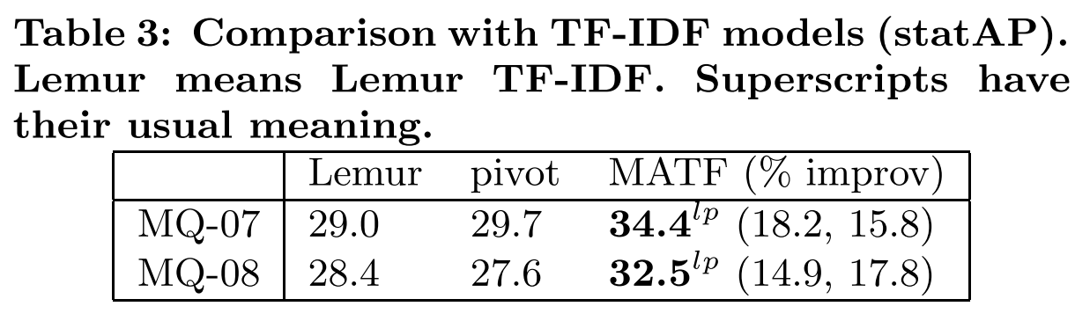
RESULTS
The performances of MATF and the two TF-IDF models on two million query data, measured by statistical average precision, are shown in Table 3. In summary, based on the results shown in Table 2 and Table 3 we can infer that MATF outperforms two state of the art TF-IDF models with remarkable significance and consistency, and the performance differences are often noticeably large. Moreover, the results also show that MATF is more effective for larger web collections.

Slide 31
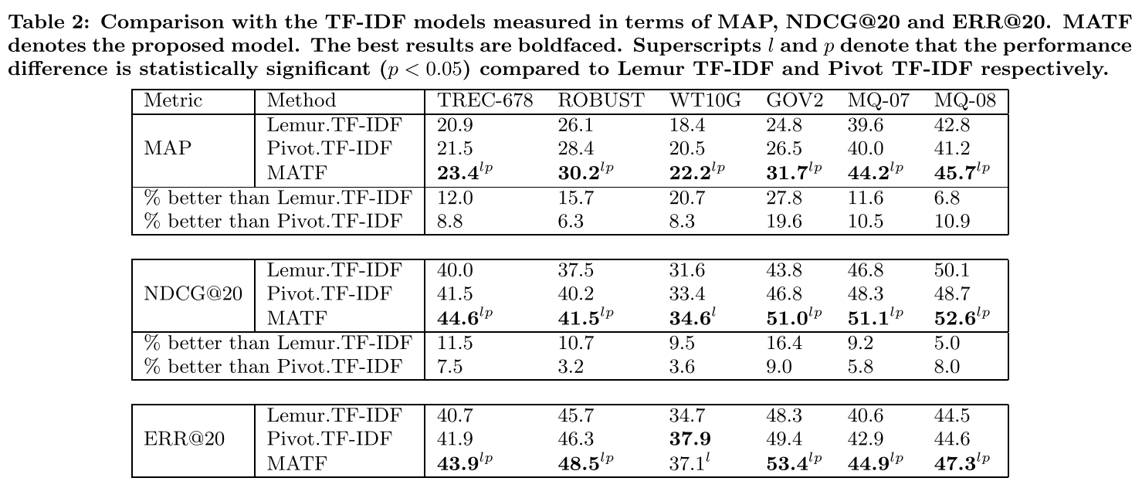
RESULTS

Slide 32
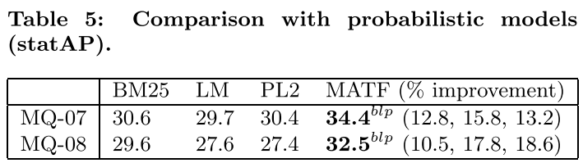
RESULTS
Table 5 compares the performance of four models for million query collections measured in terms of statistical average precision. It is once again clearly evident that MATF is consistently better than all three models and all the differences are very large and it is very consistent with the performance measured in terms other metrics presented in Table 4.

Slide 33
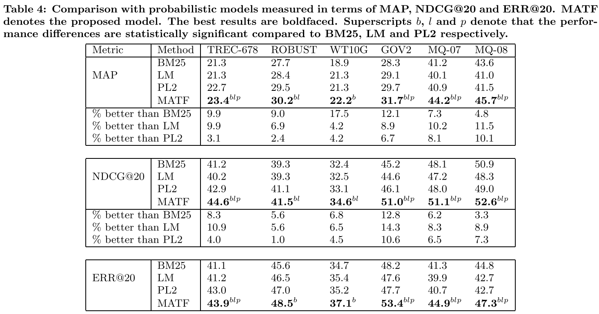
RESULTS

Slide 34
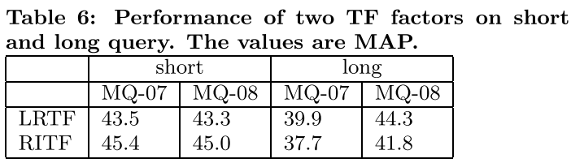
Analysis
In this section we analyze the effect of the two TF factors on short and long queries. For this analysis we choose the two million query collections, primarily because the collections have large number of queries. We divide the queries in two sets. The queries having at most 5 terms are denoted as short, while the rest of the queries (longer than 5 words) are treated as long. The results seem to confirm our aforesaid assumption. LRTF always performs better than RITF on both of the collections for long queries, while RITF does better for short queries. However, the performance differences between the methods on longer queries are noticeably better than that for shorter queries.

Slide 35
CONCLUSION
In this paper, we present a novel TF-IDF term weighting scheme. The proposed term weighting scheme employs two aspects of within document term frequency normalization to determine the importance of a term. One component of the term frequency tends to prefer short documents, while the other tends to prefer long documents. Experiments carried out on a set of news and web collections show that the proposed model outperforms two well known state of the art TF-IDF baselines with significantly large margin, when measured in terms of MAP and NDCG. The model also surpasses three state of the art probabilistic models with remarkable significance almost always. Moreover, the proposed model is also significantly better than all of the five baselines in improving precision.

Slide 36
Thank you

